Slide 1
Introduction to Data Mining

Slide 2
Why Data Mining?
The Explosive Growth of Data: from terabytes to petabytes
Data collection and data availability
Automated data collection tools, database systems, Web, computerized society
Major sources of abundant data
Business: Web, e-commerce, transactions, stocks, …
Science: Remote sensing, bioinformatics, scientific simulation, …
Society and everyone: news, digital cameras
Sensor technologies and IoT
We are drowning in data, but starving for knowledge!
Data mining—Automated analysis of massive data sets

Slide 3
Introduction
Data mining is a process to turn raw data into useful information
Data mining algorithms discover hidden potentially useful patterns in large data sets.
Data Mining is all about discovering unknown relationships amongst the data.
It is a multi-disciplinary skill that uses machine learning, statistics, AI and database technology.
Knowledge discovery in databases (KDD)

Slide 4
Data Analysis and Decision support
Market Analysis and management
Where does the data come from?
Credit card transactions, discount coupons, customer complaint calls
Target marketing
Find clusters of “model” customers who share the same characteristics: interest, income level, spending habits, etc.
Determine customer purchasing patterns over time
Risk analysis and management
Forecasting, customer retention, quality control, competitive analysis
Fraud detection and detection of unusual patterns (outliers)

Slide 5
Other Applications
Text mining (news group, email, documents) and Web mining
Stream data mining
Bioinformatics and bio-data analysis
Applications are closely connected to the problems in Data Mining: (1) association pattern mining, (2) clustering, (3) classification and (4) outlier detection

Slide 6
Data Mining: A KDD Process
Knowledge
Data mining—core of knowledge discovery process
Pattern Evaluation
Data Mining
Task-relevant Data
Data Warehouse
Selection
Data Cleaning
Data Integration
Databases

Slide 7
Challenges
Data types: quantitative (age), categorical (gender), text, spatial, temporal or graph oriented, Time series
Dimensionality
Continuously collected data (data streams), needs real time analysis
Data dependency or non-dependency of data
Inconsistent data
Representation of data
Choosing functions of data mining: Summarization, classification, regression, association, clustering.

Slide 8
Data Cleaning and Preprocessing
The data from different sources should be collected, cleaned, transformed, formatted, anonymized, and constructed.
Data cleaning is a process to "clean" the data by smoothing noisy data, scaling, normalization, dropped and filling in missing values.
Relevant features need to be extracted for processing, called feature extraction.
Converting different forms of data: Discretization, Binarization….

Slide 9
Data Cleaning
Data cleaning is important because error associated with the data collection process.
Scaling and normalization is important to provide equal effect for different features.
Estimating missing value, eliminating missing record have direct impact on the classification problem.
Handling incorrect entries by identifying the data points which are inconsistent with the remaining data distribution, such noisy data points are called outliers.

Slide 10



Scaling and Normalization
min-max scaling or min-max normalization, rescaling the range of features to scale the range in [0, 1] or [−1, 1].
Mean normalization
Standardization

Slide 11
Data Reduction
The goal of data reduction is to represent the data more compact way so that less computational time is required to execute the algorithms.
The reduction of data in terms of row (records) or in terms of columns (dimension).
Data reduction results loss of information.
Different types of data reduction:
Data Sampling, Feature Selection and Correlation in the data for dimensionality reduction

Slide 12
Sampling
Data sampling is a statistical analysis technique used to select, manipulate and analyze a representative subset of data points to identify the patterns and trends in the larger data set being examined.
Random Sampling: select a subset of a population in which each member of the subset has an equal probability of being chosen.
Biased Sampling: Some parts of the data are given importance. More recent records have a larger chance of being included.
p(X) ∝ e^{-λ.δt} , sample X is generated δt time ago and regulated by decay parameter λ.

Slide 13
Sampling
Stratified Sampling: The total population is divided into smaller groups or strata based on some common characteristics and then randomly selects the sample.
Reservoir Sampling for Data streams: Goal is to grab a small sample with uniform probability. k items are chosen.
For a reservoir of size k, the first k data points from a list with n different items in the stream are used to initialize the reservoir.
The chance for any item to be selected further is k/n.
To insert the newly incoming data point, eject one of the old k data points at random.

Slide 14
Feature Selection
Some features are important, so selected and some are irrelevant, therefore discarded.
Unsupervised feature selection: Removal of noisy and redundant attributes.
Supervised feature selection: The features that can predict the class attribute effectively are the most relevant.
Reason of Feature Selection:
shorter training times,
avoid the curse of dimensionality,
enhanced generalization by reducing overfitting

Slide 15
Some basic operations
Predictive:
Regression
Classification
Collaborative Filtering
Descriptive:
Clustering / similarity matching
Association rules and variants
Deviation detection
Notes:
Each topic is a talk..

Slide 16
Classification (Supervised learning)

Slide 17
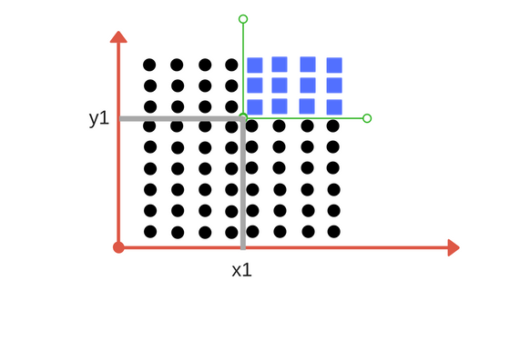
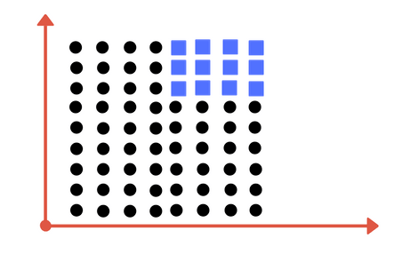
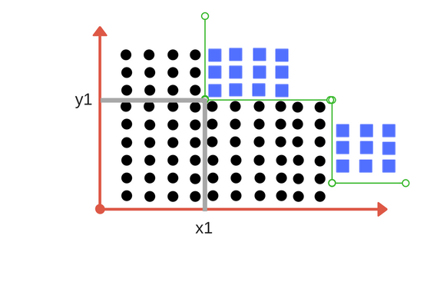
Decision Tree Classifier
Is it possible to draw a single separation line ?
We need more than one line, to divide into classes, according to threshold value of x and other for threshold value of y.
Decision Tree Classifier, repetitively divides the working area(plot) into sub part by identifying lines.

Slide 18
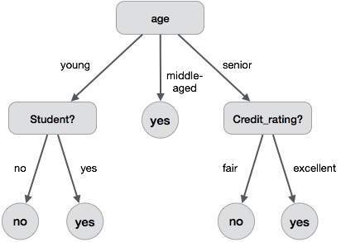
Division based on some features

Slide 19
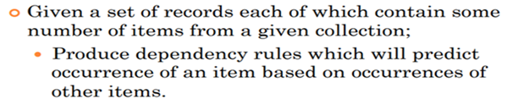
Association Rule
The Association rule is a learning technique that helps identifying the dependencies between two data items.
Association rule looks for interesting associations among the variables of the dataset.
“If a customer buys bread, he’s 70% likely of buying milk.”
Bread → Milk

Slide 20
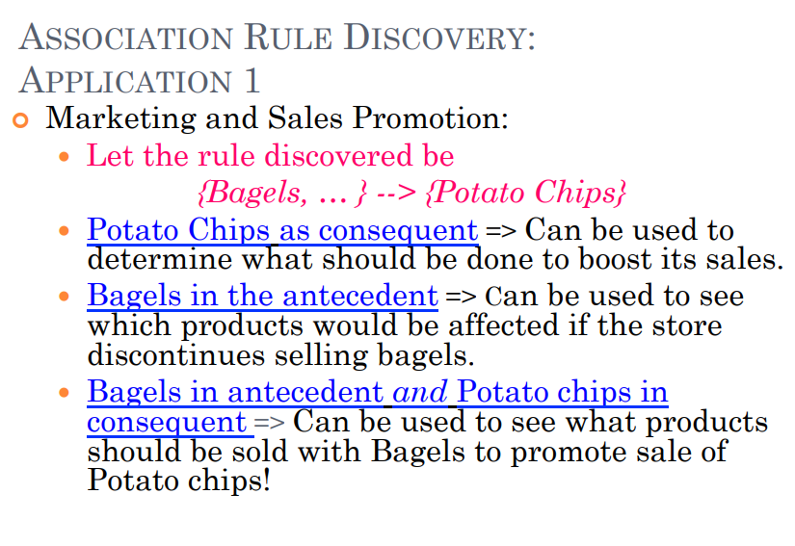

Slide 21
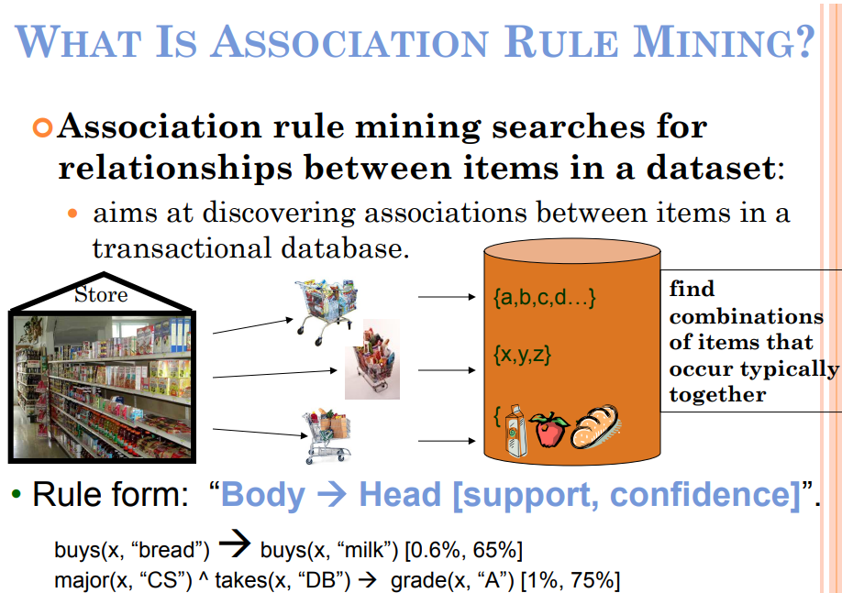

Slide 22
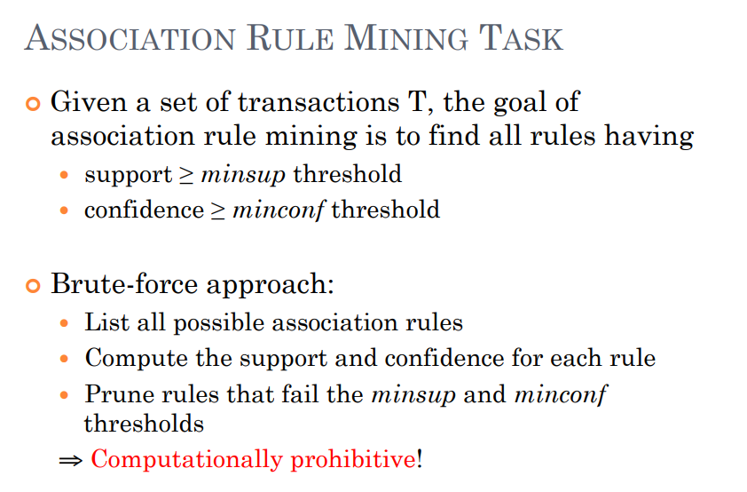

Slide 23
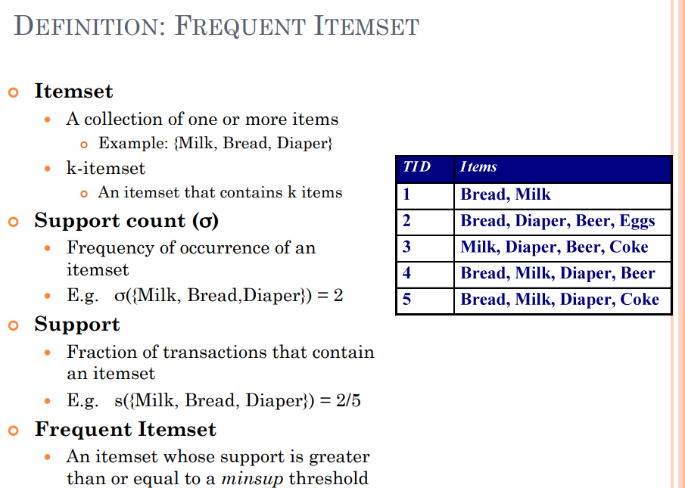



To measure the associations between thousands of data items, there are several metrics.
Lift
It is the strength of any rule, which can be defined as :

Slide 24
Lift
Lift is the ratio of the observed support measure and expected support if X and Y are independent of each other.
It has three possible values:
If Lift= 1: The probability of occurrence of antecedent and consequent is independent of each other.
Lift>1: It determines the degree to which the two itemsets are dependent to each other.
Lift<1: It tells us that one item is a substitute for other items, which means one item has a negative effect on another.

Slide 25
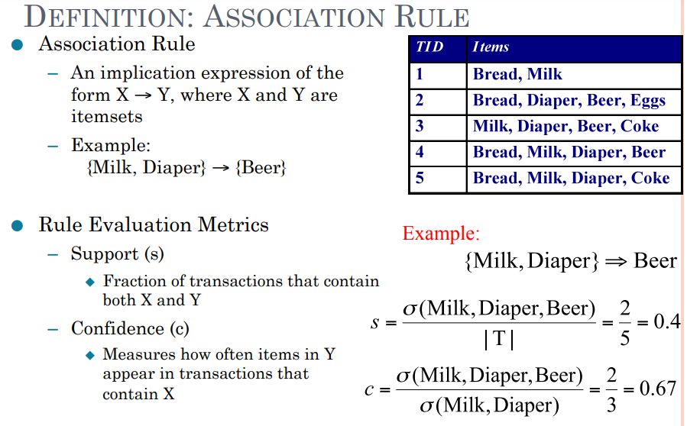

Slide 26
Apriori Algorithm
Apriori algorithm is given by R. Agrawal and R. Srikant in 1994 for finding frequent itemsets in a dataset for boolean association rule.
Name of the algorithm is Apriori because it uses prior knowledge of frequent itemset properties.
Apriori Property – All subsets of a frequent itemset must be frequent(Apriori property). If an itemset is infrequent, all its supersets will be infrequent.

Slide 27
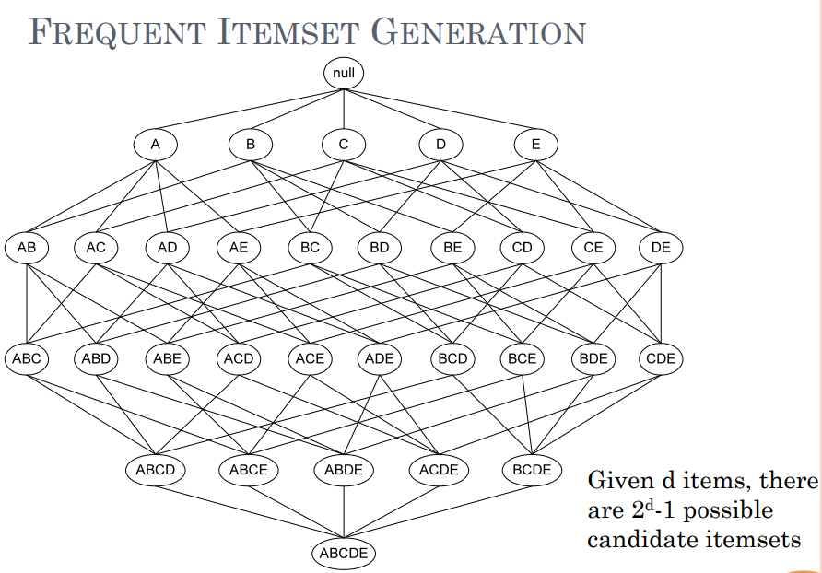
Breadth First Search Approach

Slide 28
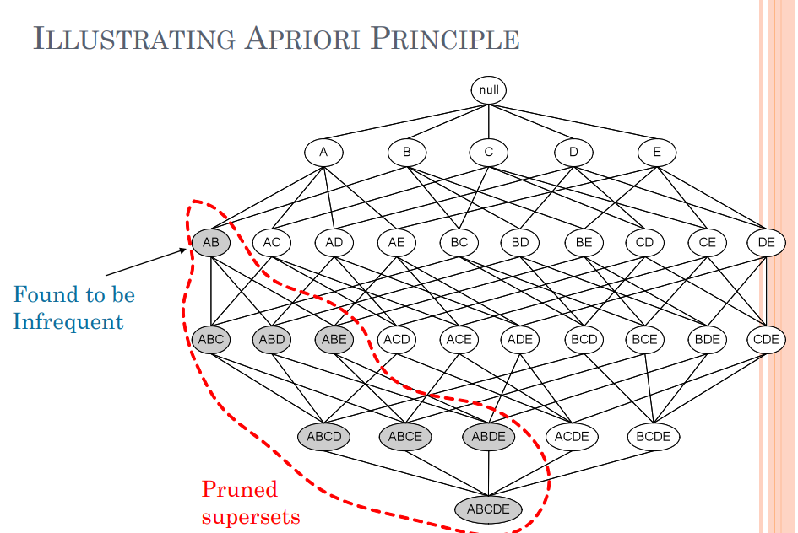

Slide 29
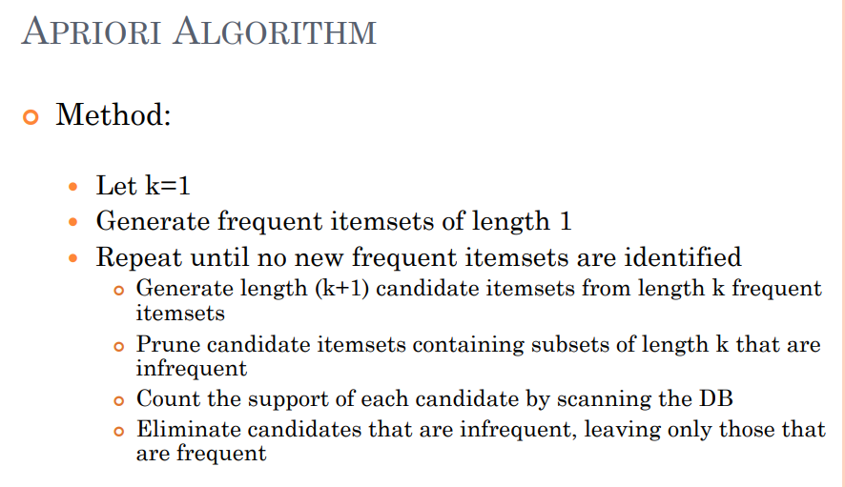

Slide 30
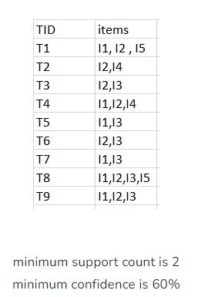
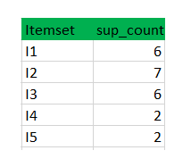
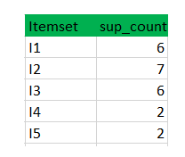
Apriori Algorithm
Step-1: K=1 (I) Create a table containing support count of each item present in dataset – Called C1(candidate set)
(II) compare candidate set item’s support count with minimum support count(here min_support = 2 if support_count of candidate set items is less than min_support then remove those items).
itemset L1

Slide 31
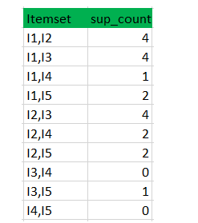
Step-2: K=2
Generate candidate set C2 using L1 (this is called join step). Condition of joining L_{k-1} and L_{k-1} is that it should have (K-2) elements in common.
Check all subsets of an itemset are frequent or not and if not frequent remove that itemset.(Example subset of{I1, I2} are {I1}, {I2} they are frequent.Check for each itemset)
Now find support count of these itemsets by searching in dataset.
(II) compare candidate (C2) support count with minimum support count(here min_support=2 if support_count of candidate set
item is less than min_support then remove those items)
this gives us itemset L2.

Slide 32
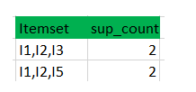
Step-3:
Generate candidate set C3 using L2 (join step). Condition of joining L_{k-1} and L_{k-1} is that it should have (K-2) elements in common. So here, for L2, first element should match. So itemset generated by joining L2 is {I1, I2, I3}{I1, I2, I5}{I1, I3, i5}{I2, I3, I4}{I2, I4, I5}{I2, I3, I5}
Check if all subsets of these itemsets are frequent or not and if not, then remove that itemset.(Here subset of {I1, I2, I3} are {I1, I2},{I2, I3},{I1, I3} which are frequent. For {I2, I3, I4}, subset {I3, I4} is not frequent so remove it. Similarly check for every itemset)
find support count of these remaining itemset by searching in dataset.
(II) Compare candidate (C3) support count
with minimum support count(here min_support=2
if support_count of candidate set item is less than
min_support then remove those items) this gives us itemset L3.

Slide 33
Step-4:
Generate candidate set C4 using L3 (join step). Condition of joining L_{k-1} and L_{k-1} (K=4) is that, they should have (K-2) elements in common. So here, for L3, first 2 elements (items) should match.
Check all subsets of these itemsets are frequent or not (Here itemset formed by joining L3 is {I1, I2, I3, I5} so its subset contains {I1, I3, I5}, which is not frequent). So no itemset in C4
We stop here because no frequent itemsets are found further.
So, we have discovered all the frequent item-sets.

Slide 34
Now generation of strong association rule by calculating confidence of each rule.
Confidence – A confidence of 60% means that 60% of the customers, who purchased milk and bread also bought butter.
Confidence(A->B)=Support_count(A∪B)/Support_count(A)
So here, by taking an example of any frequent itemset, we will show the rule generation. Itemset {I1, I2, I3} //from L3 SO rules can be [I1^I2]=>[I3] //confidence = sup(I1^I2^I3)/sup(I1^I2) = 2/4*100=50% [I1^I3]=>[I2] //confidence = sup(I1^I2^I3)/sup(I1^I3) = 2/4*100=50% [I2^I3]=>[I1] //confidence = sup(I1^I2^I3)/sup(I2^I3) = 2/4*100=50% [I1]=>[I2^I3] //confidence = sup(I1^I2^I3)/sup(I1) = 2/6*100=33% [I2]=>[I1^I3] //confidence = sup(I1^I2^I3)/sup(I2) = 2/7*100=28% [I3]=>[I1^I2] //confidence = sup(I1^I2^I3)/sup(I3) = 2/6*100=33%
So if minimum confidence is 50%, then first 3 rules can be considered as strong association rules.

Slide 35
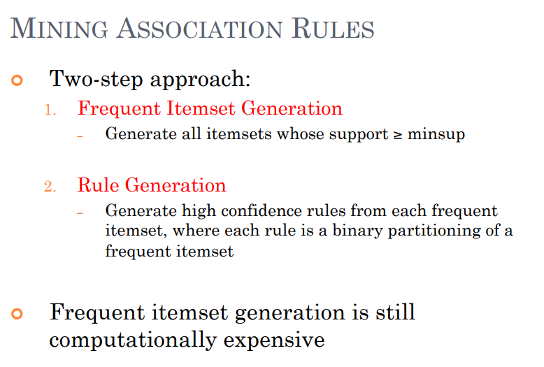

Slide 36
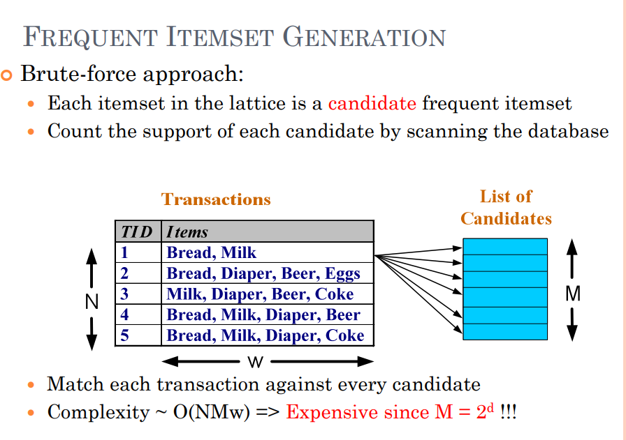

Slide 37
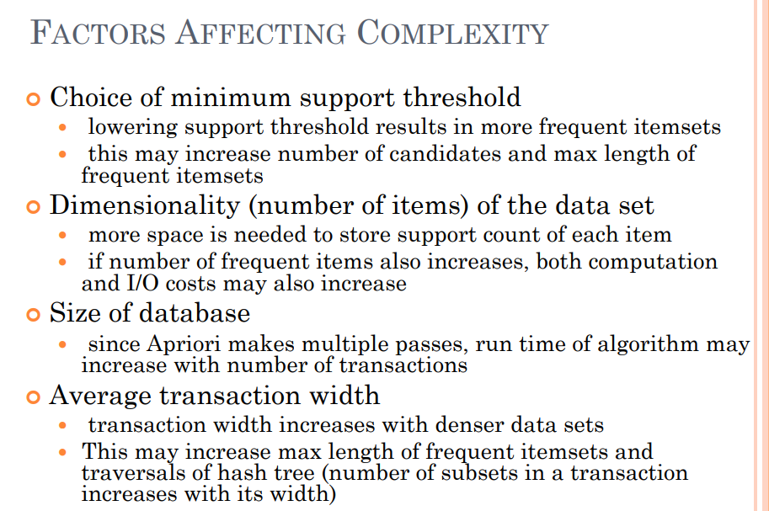

Slide 38
